Slide 1

ASTERISM
A
to the
of the
Journey
Heart
BEAM
> START <

Slide 2
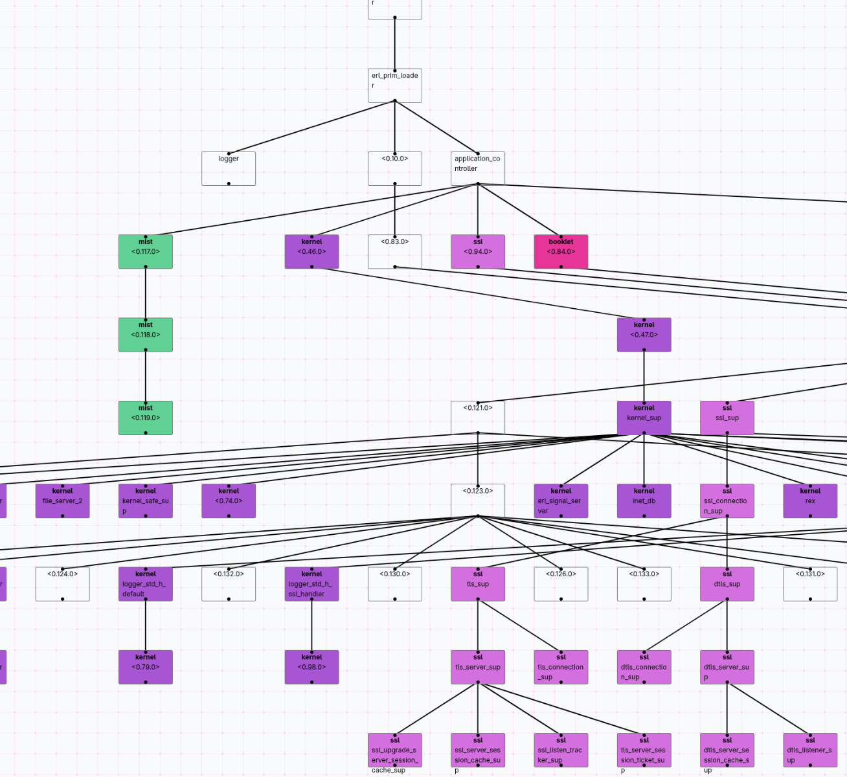
ASTERISM

Slide 3
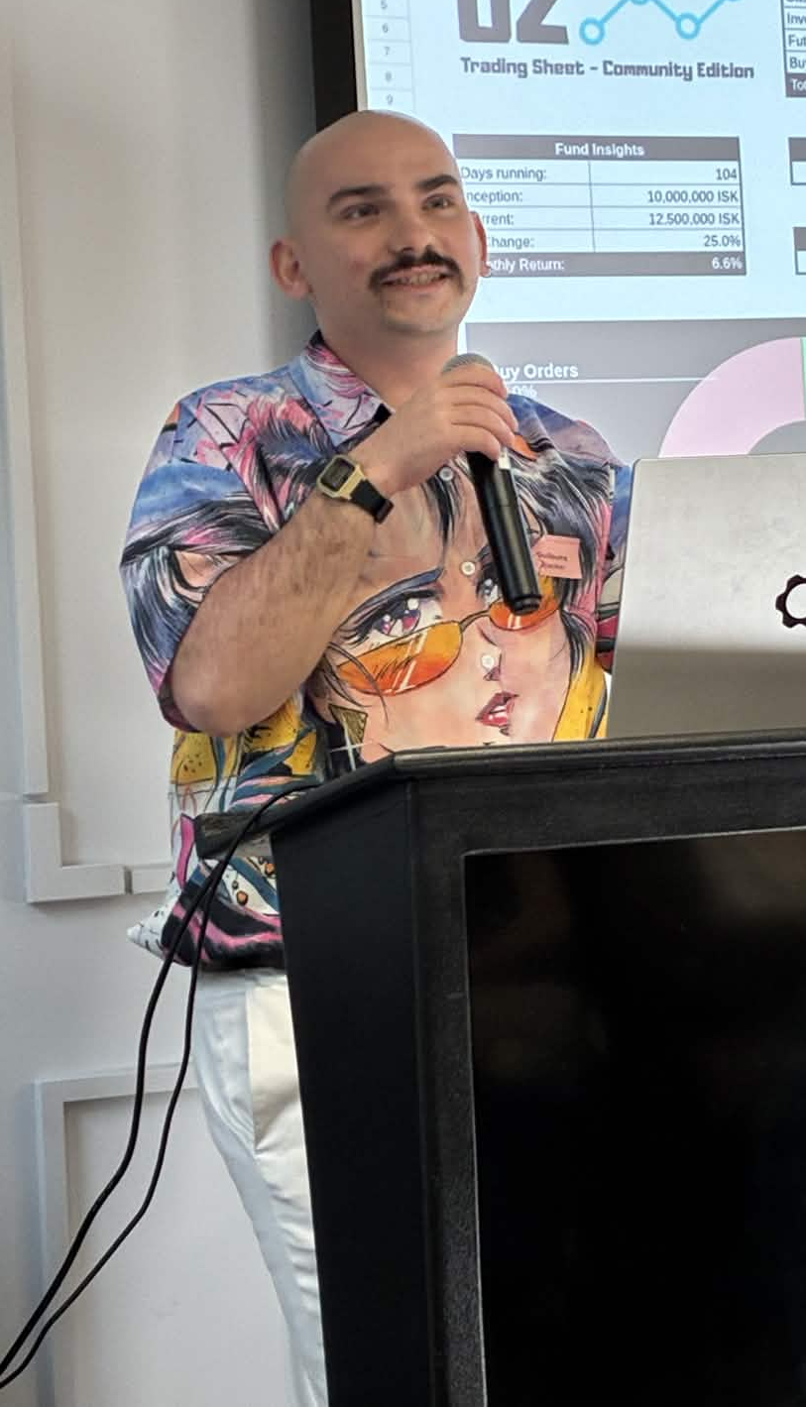
Guillaume Heu
Cisco instructor
DevOps/SysAdmin
Recovering Nix-aholic
Student (Grenoble UGA)
Avid Gleamlin!

Slide 4
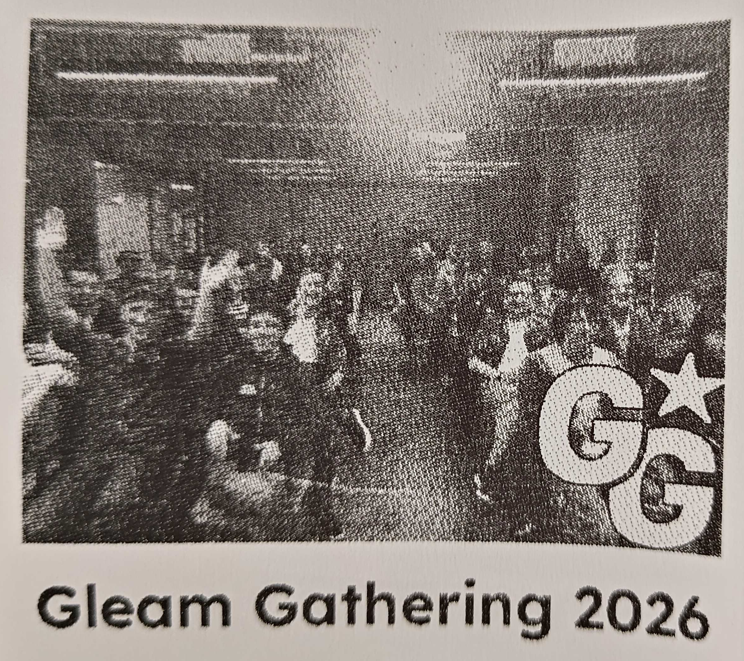

Slide 5
Goals
Represent
a BEAM node’s process tree
Identify supervision relationships
Highlight isolated processes
messages being passed between processes
Collapse supervision trees
Animate

Slide 6
Part 1
OTP is not BEAM

Slide 7

The OTP Iceberg
processes
links
workers
supervisors
GenServer / Gleam actors
applications
kernel
simple_one_for_one
group leader
trap_exit flag
heart

Slide 8
Represent a BEAM node’s process tree
Not so fast...

Slide 9
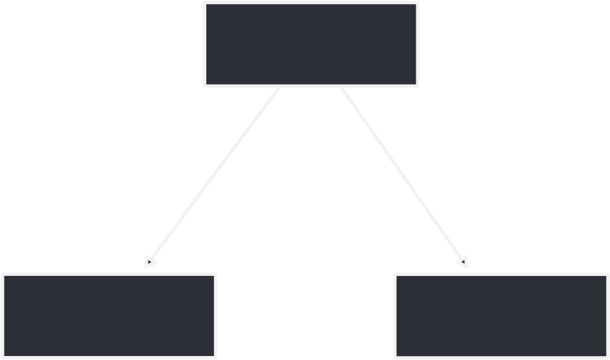
Process Graph
Is a tree?
supervisor
worker 1
worker 2

Slide 10
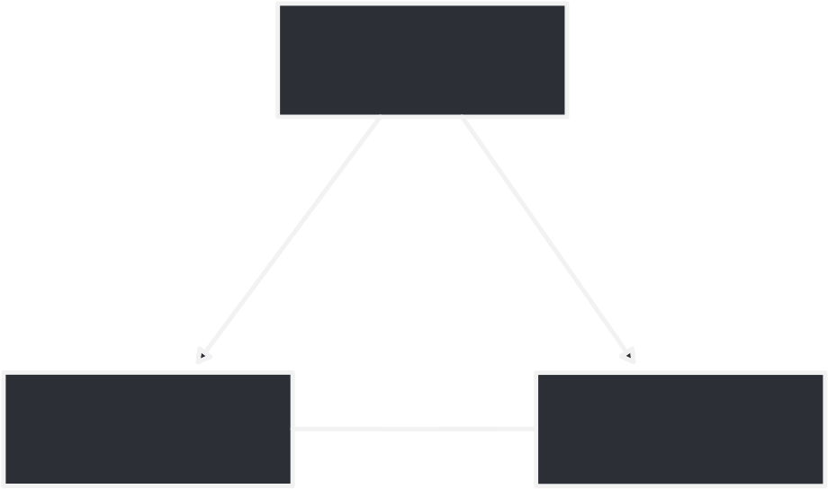
Process Graph
Not a tree!
supervisor
worker 1
worker 2

Slide 11

Process Graph
Not even directed!
supervisor
worker 1
worker 2

Slide 12
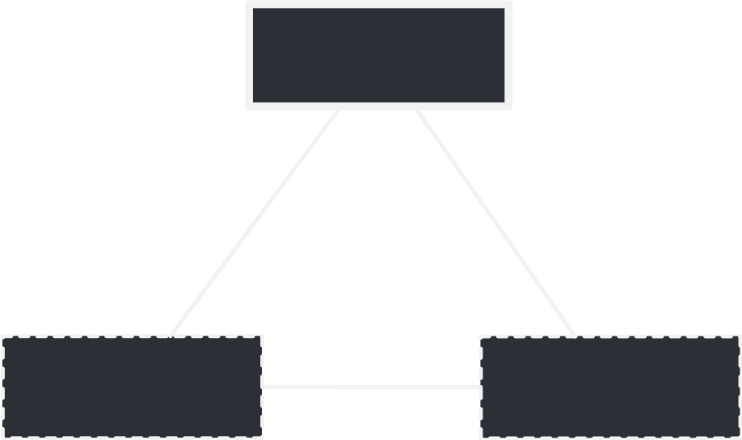
Process Graph
Not even a real supervisor!!!
trap_exit = true
supervisor
worker 1
worker 2
trap_exit = false
trap_exit = false

Slide 13
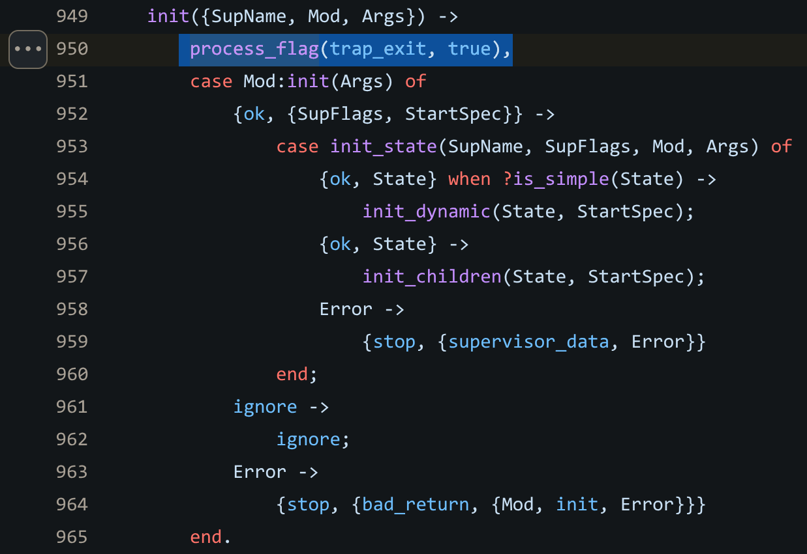
https://github.com/erlang/otp/blob/OTP-29.1/lib/stdlib/src/supervisor.erl#L950

Slide 14
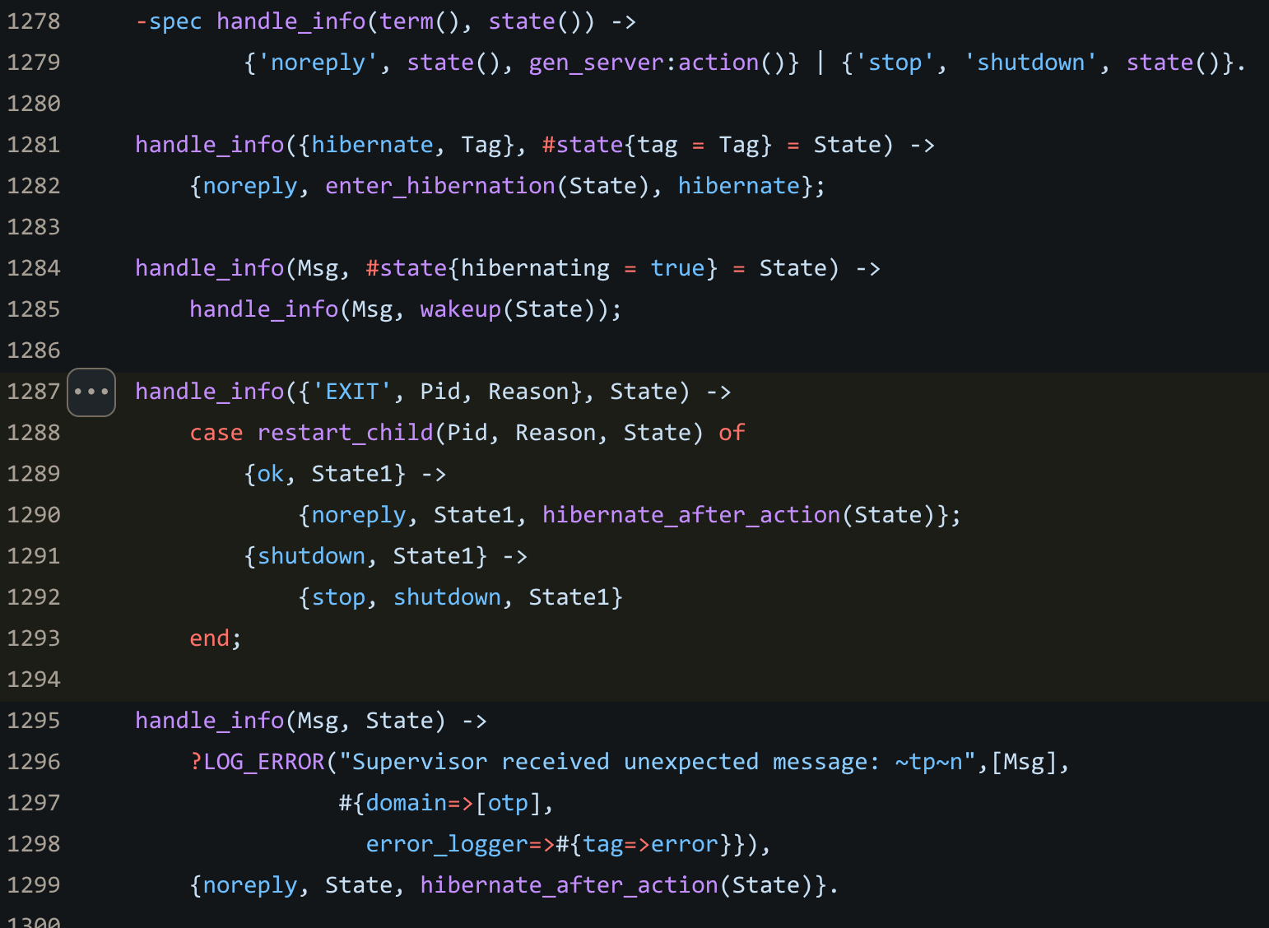
https://github.com/erlang/otp/blob/OTP-29.1/lib/stdlib/src/supervisor.erl#L1287

Slide 15
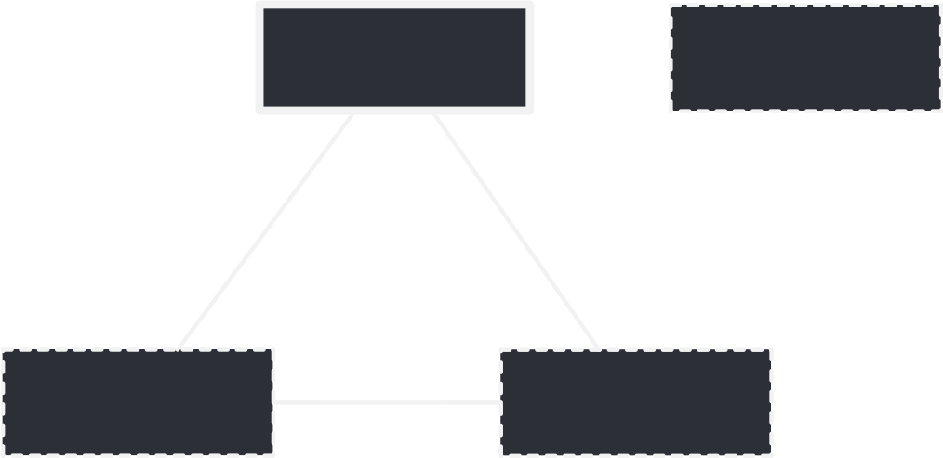
Supervision
external
process
supervisor
worker 1
worker 2

Slide 16
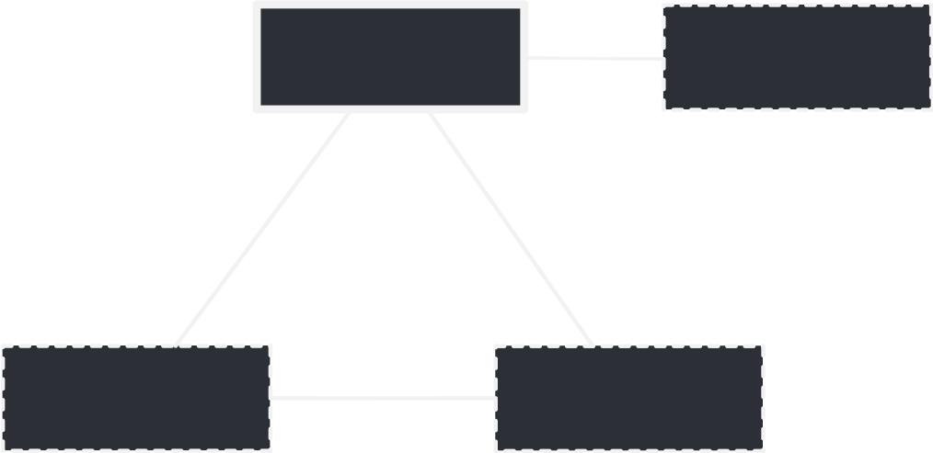
Supervision
external
process
supervisor
worker 1
worker 2

Slide 17
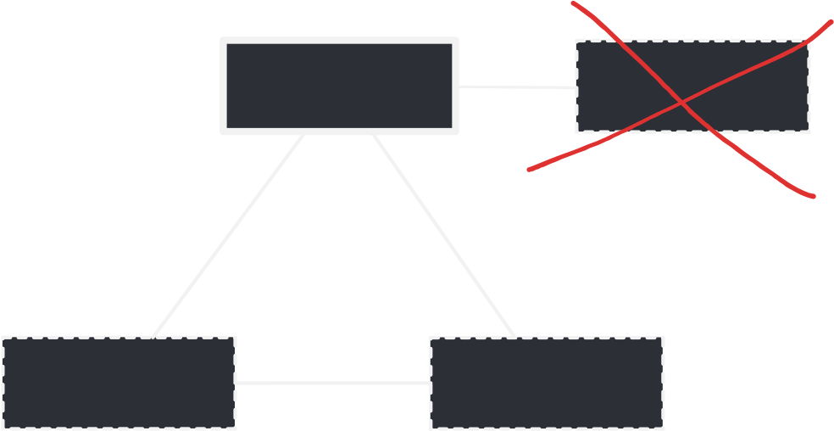
Supervision
external
process
supervisor
worker 1
worker 2

Slide 18

Process forest

Slide 19
Goals
Represent
a BEAM node’s process tree
Identify supervision relationships
Highlight isolated processes
messages being passed between processes
Collapse supervision trees
Animate

Slide 20
What’s a supervisor?

Slide 21
What’s a supervisor?
Process (can receive messages)

Slide 22
What’s a supervisor?
Process (can receive messages)
trap_exit = true

Slide 23
What’s a supervisor?
Process (can receive messages)
trap_exit = true
Keeps a state of its children

Slide 24
What’s a supervisor?
Process (can receive messages)
trap_exit = true
Keeps a state of its children
Has a restart strategy

Slide 25
What’s a supervisor?
Process (can receive messages)
trap_exit = true
Keeps a state of its children
Has a restart strategy
Is a gen server

Slide 26
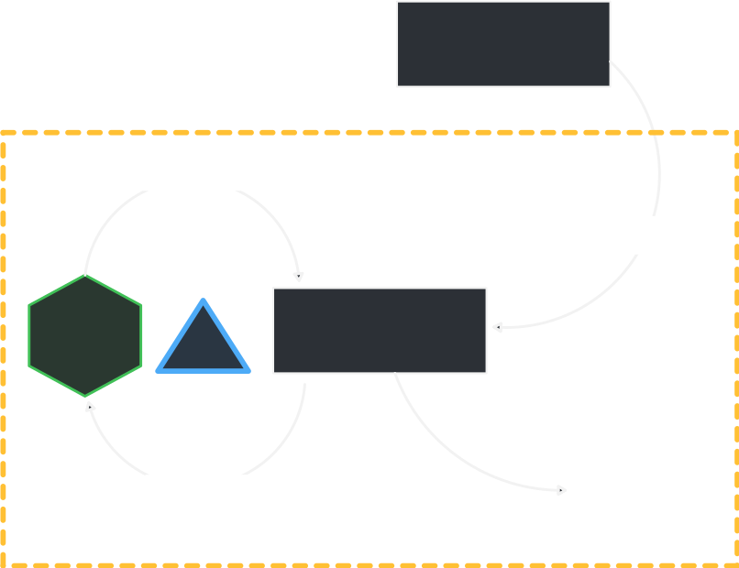
What’s a gen server?
Initiating
process
gen server
handle
message
Spawn with init
gen server
process
MSGs
state
read
message
terminate

Slide 27
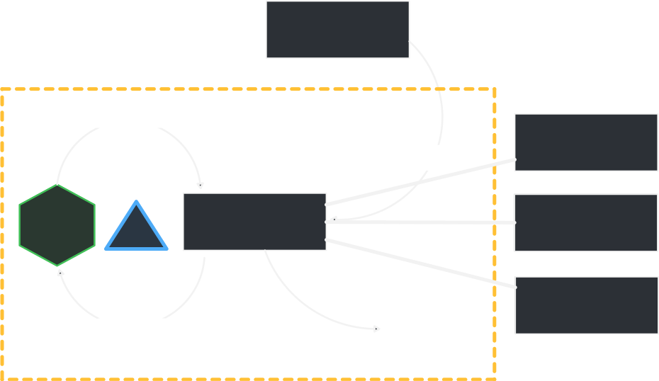
What’s a supervisor?
Initiating
process
supervisor
handle
message
worker 1
Spawn with init
gen server
process
MSGs
worker 2
state
(children)
read
message
worker 3
terminate

Slide 28
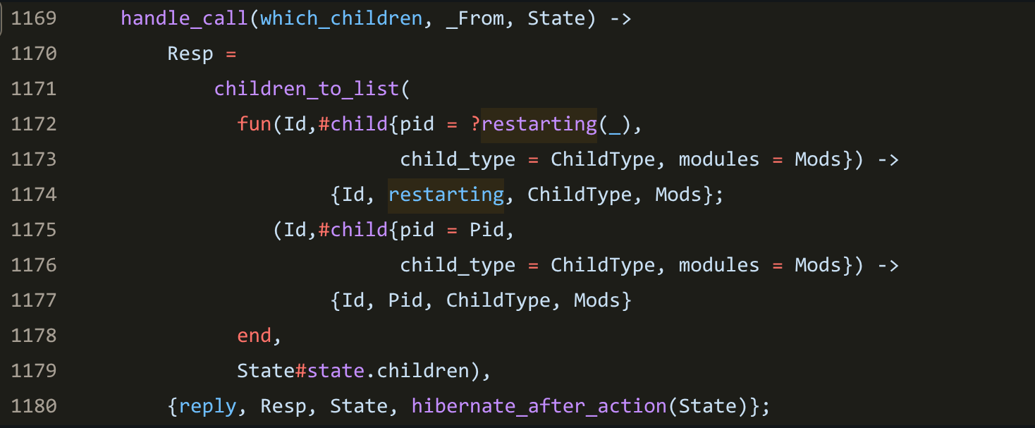
Identifying a supervisor
Just send it a message!

Slide 29
I ran into a problem...

Slide 30

Identifying a supervisor
Process A
(mapping the forest)
Process B
Process C
Process D

Slide 31
Identifying a supervisor
Process A
(mapping the forest)
Are you a supervisor?
supervisor:which_children(Pid)
Process B
Process C
Process D

Slide 32
Identifying a supervisor
Process A
(mapping the forest)
Are you a supervisor?
supervisor:which_children(Pid)
Yes!
<List of PIDs>
Process B
Process C
Process D

Slide 33

Identifying a supervisor
Process A
(mapping the forest)
Are you a supervisor?
supervisor:which_children(Pid)
Yes!
<List of PIDs>
Process B
Process C
Process D

Slide 34

Identifying a supervisor
Process A
(mapping the forest)
Are you a supervisor?
A what now?
Process B
Process C
Process D

Slide 35

Identifying a supervisor
Process A
(mapping the forest)
Am I a supervisor?
Process B
Process C
Process D

Slide 36

Identifying a supervisor
Process A
(mapping the forest)
You’ve got mail!
Am I a supervisor?
Process B
Process C
Process D

Slide 37
Identifying a supervisor
Process A
(mapping the forest)
You’ve got mail!
Am I a supervisor?
Hold on, I’m busy
waiting for a reply...
Process B
Process C
Process D

Slide 38

Identifying a supervisor
Process A
(mapping the forest)
You’ve got mail!
Am I a supervisor?
Hold on, I’m busy
waiting for a reply...
Process B
Process C
Process D

Slide 39
Identifying a supervisor
Process A
(mapping the forest)
Process B
Process C
Process D

Slide 40

Identifying a supervisor
Process A
(mapping the forest)
Process B
Process C
Process D

Slide 41
Identifying a supervisor
Does this process even
look like a supervisor?
Process A
(mapping the forest)
Process B
Process C
Process D

Slide 42
Identifying a supervisor
Does this process even
look like a supervisor?
Process A
(mapping the forest)
process_info(Pid, ...)
Process B
Process C
Process D

Slide 43
Identifying a supervisor
Process A
(mapping the forest)
Nevermind...
Process B
Process C
Process D

Slide 44
Identifying a supervisor
Process A
(mapping the forest)
process_info(Pid, ...)
Process B
Process C
Process D

Slide 45
Goals
Represent
a BEAM node’s process tree
Identify supervision relationships
Highlight isolated processes
messages being passed between processes
Collapse supervision trees
Animate

Slide 46
Part 2
Putting it all on canvas

Slide 47
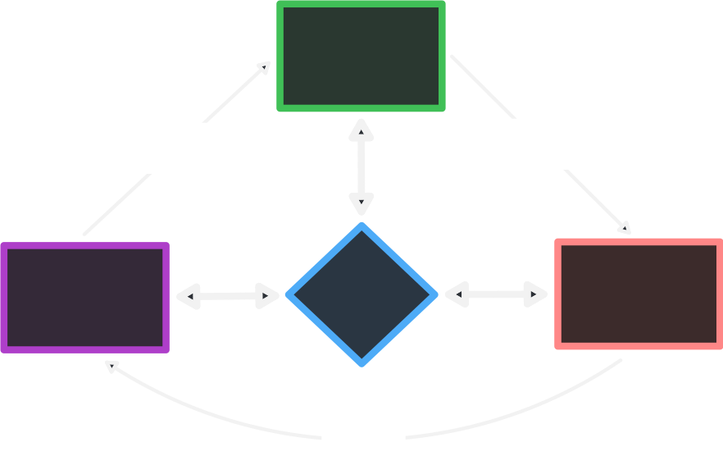
Lustre
View
model
gets drawn
user sends
updates
Model
Lustre
Update
updates
the model

Slide 48
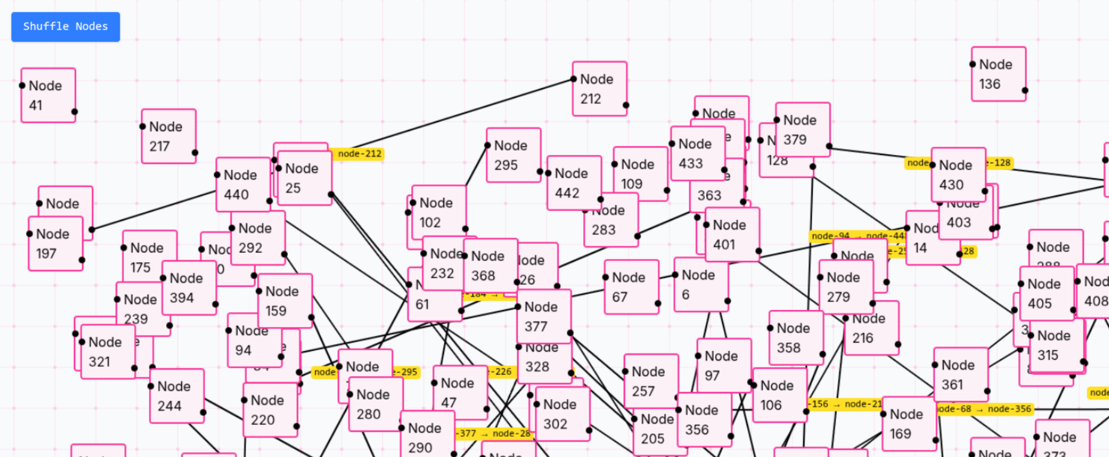
Lustre
and Clique
https://github.com/hayleigh-dot-dev/clique
Caveats:
- No layout algorithm
- Not published
- Still a WIP

Slide 49
Layouts
Is mayonnaise a layout?

Slide 50
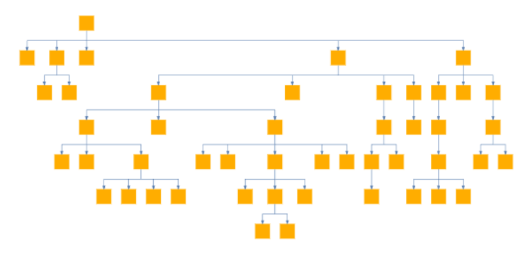
Layouts
Is mayonnaise a layout?
Tree

Slide 51
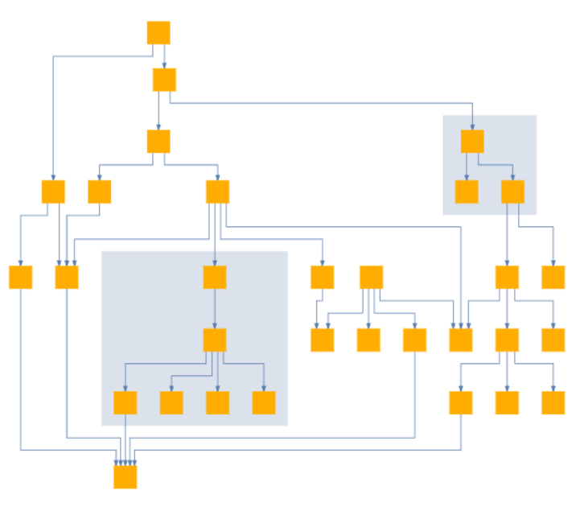
Layouts
Is mayonnaise a layout?
Tree
Hierarchical

Slide 52
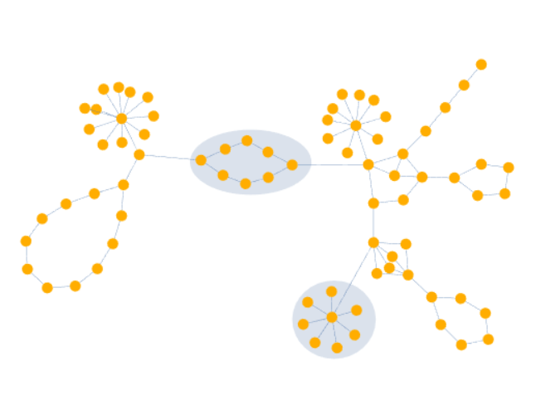
Layouts
Is mayonnaise a layout?
Tree
Organic (force-directed)
Hierarchical

Slide 53
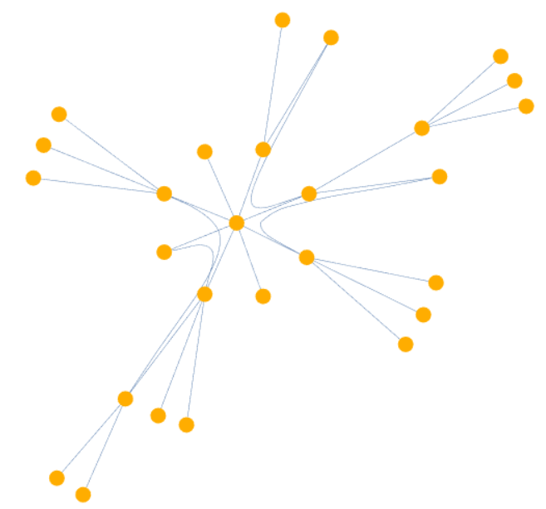
Layouts
Is mayonnaise a layout?
Tree
Organic (force-directed)
Hierarchical
Radial

Slide 54
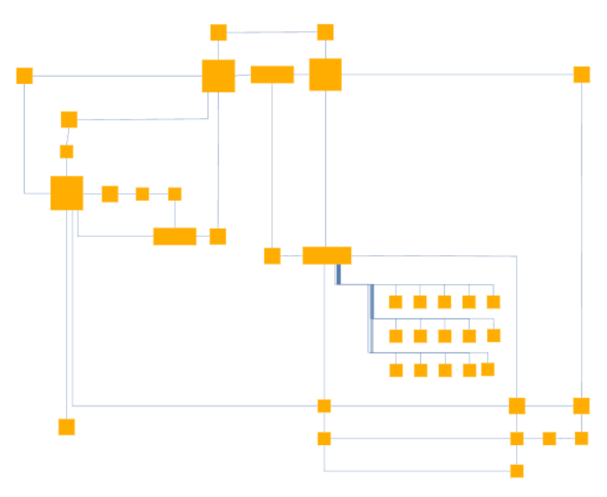
Layouts
Is mayonnaise a layout?
Tree
Organic (force-directed)
Hierarchical
Radial
Orthogonal

Slide 55

Sugiyama

Slide 56
Sugiyama

Slide 57



Layouts
That’s what I call “Caving”!

Slide 58
Sugiyama
https://github.com/guillheu/sugiyama-gleam
Re-implementing solved problem
Big time gain (my head hurts)
Prototype

